Slide 1
IRAI
Softwares for industries
and schools
November 2014

Slide 2
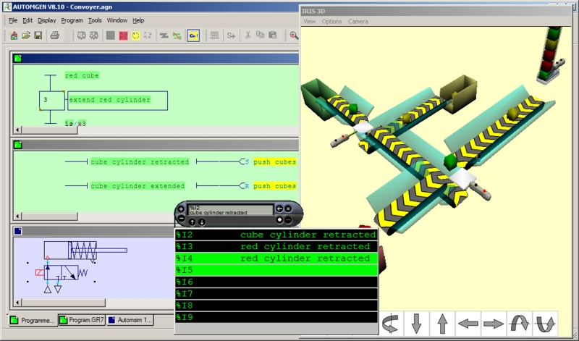
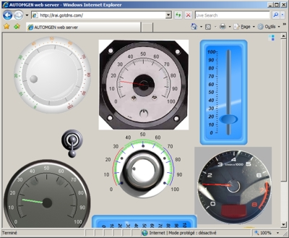
AUTOMGEN
Automation workshop for PLCs and other targets (Arduino, PIC, etc.) programs creation and simulation, local HMI or web HMI creation. IEC 1131-3 languages. 3D simulation, fluid and electric simulation (Automsim option), SysML, Mathworks Simulink like diagrams, National Instrument Labview like functionnalities, drive I/O cards (Soft PLC)

Slide 3
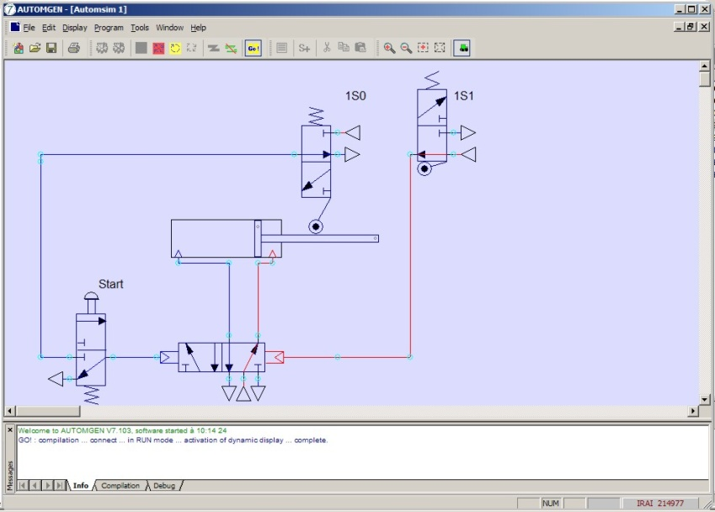
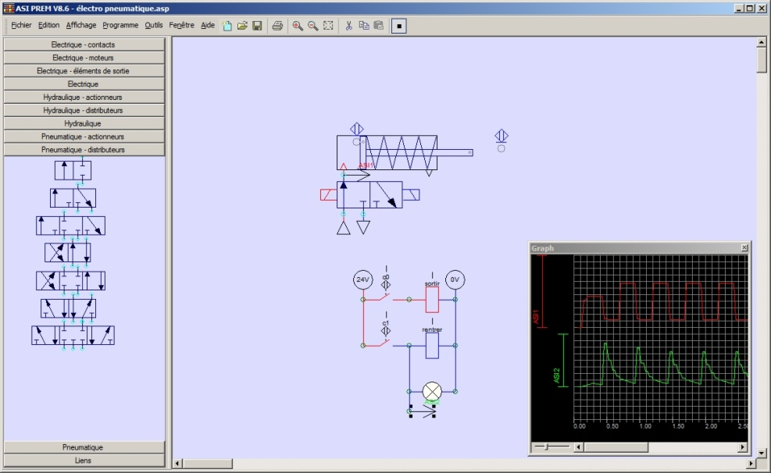
AUTOMSIM
Electric, pneumatic, hydraulic and digital electronic diagrams creation and simulation. Large library of components, affordable prices.

Slide 4
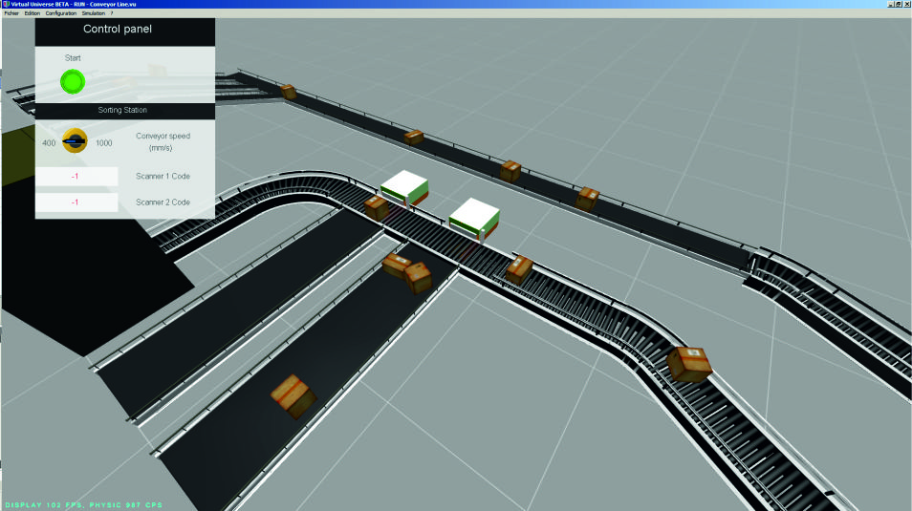
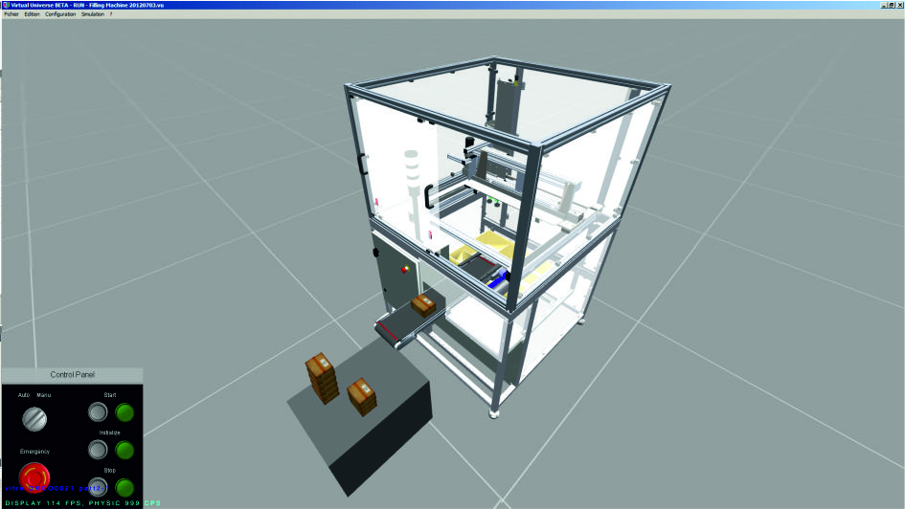
VIRTUAL UNIVERSE PRO
3D process simulation creation and simulation software. Use prebuilt models or create your own from a components library or by importing from the main CAD softwares (DS Solidworks, Autodesk Inventor, etc.). Drive the models with the main PLCs or manufacturer softwares (Siemens, Ormon, Sehneider, Rockewell, etc.).

Slide 5
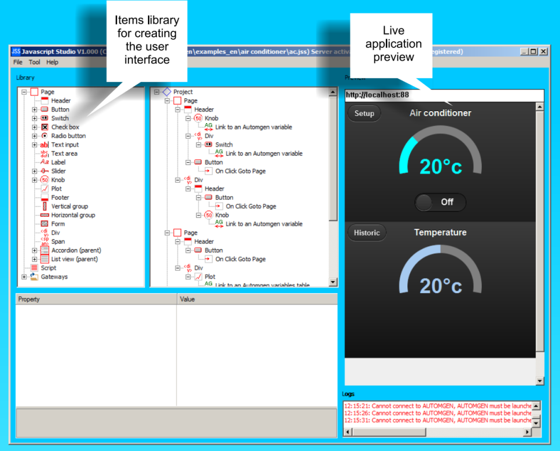
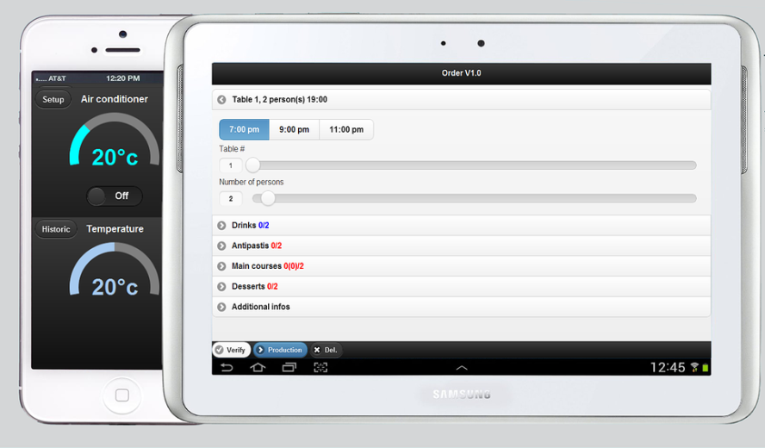
JavaScript Studio
Create great Web applications for any devices (IOs, Android, Windows Phone, etc.) and connect these applications to PLCs or other targets.

